Slide 1
B2B Social & Content Marketing
Being a Resource, Being Known, Being Trusted

Slide 2
Being a Resource

Slide 3
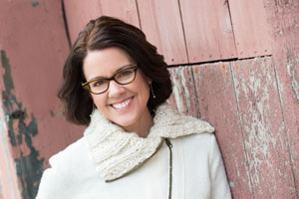
What is marketing today?
“Be relentlessly customer-focused and not corporate-focused.
Ask yourself, as a business owner…
‘What marketing will my customer
THANK me for?’”
Ann Handley
Author, Content Rules and Everybody Writes

Slide 4
I Blame My Dad, Bob Bailey
“Let’s start an email newsletter!”
The Wood Street Journal is born!
‘Turn Your Website into a Resource’
Volume 1, Issue 1
Practice what you preach!

Slide 5
Content Marketing by the Numbers
Companies that published 16+ blog posts per month got almost 3.5X more traffic than ones that published 0-4 monthly posts. (Source: HubSpot)
Content marketing costs 62% less than traditional marketing and generates about 3 times as many leads. (Source: DemandMetric)
Conversion rates are nearly 6x higher for content marketing adopters than non-adopters (2.9% vs 0.5%). (Source: Aberdeen)
But, what kind of content?

Slide 6
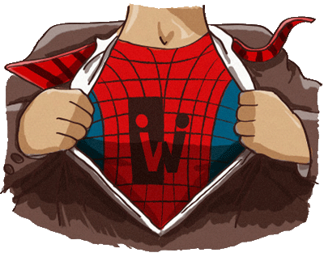
Utility Content
Content your audience devours…
How-to videos
Thought provoking posts
Tools, references, studies
Problem solving content
Timely and up-to-date content
Utility content makes you a hero to your clients!

Slide 7
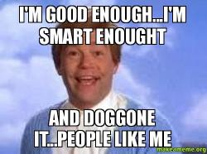
People love them some them!
Is there a sense of belonging?
Are you encouraging engagement?
Do you ask for their opinion?
Special access to gated content?
Are you giving them cool fuel?
Content they can use to build up their influence
Facts, analysis, infographics they can use?
Source – makeameme.org
Turn your audience into influencers, give them utility content!

Slide 8
Content: Hiding in Plain Sight
Content that is passing you by…
Emails
Conversations
Sales and contract content
Presentations
The world around you
Learn to spot the unique content your audience craves.

Slide 9
Repurpose and Squeeze It Dry!
Nothing is one and done in content marketing!
A post becomes a series
The series becomes a presentation
The presentation becomes an eBook
The eBook becomes a video
It’s the content marketing circle of life!

Slide 10
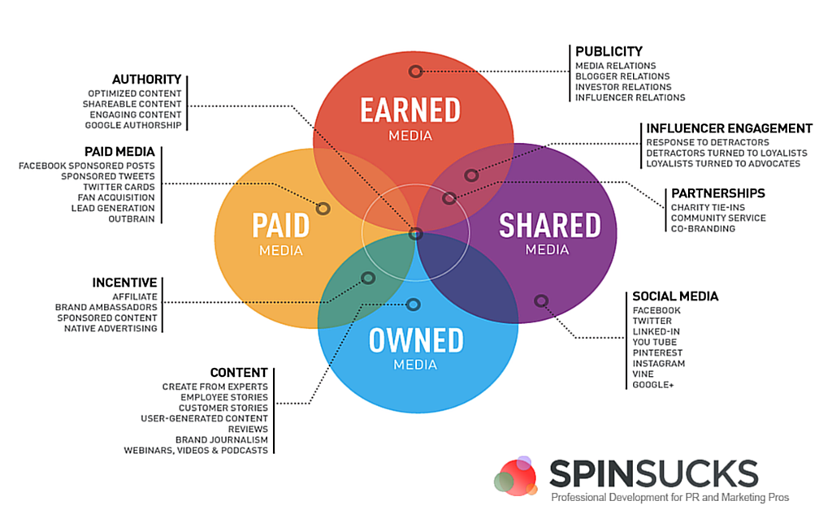

Slide 11
Being Known

Slide 12
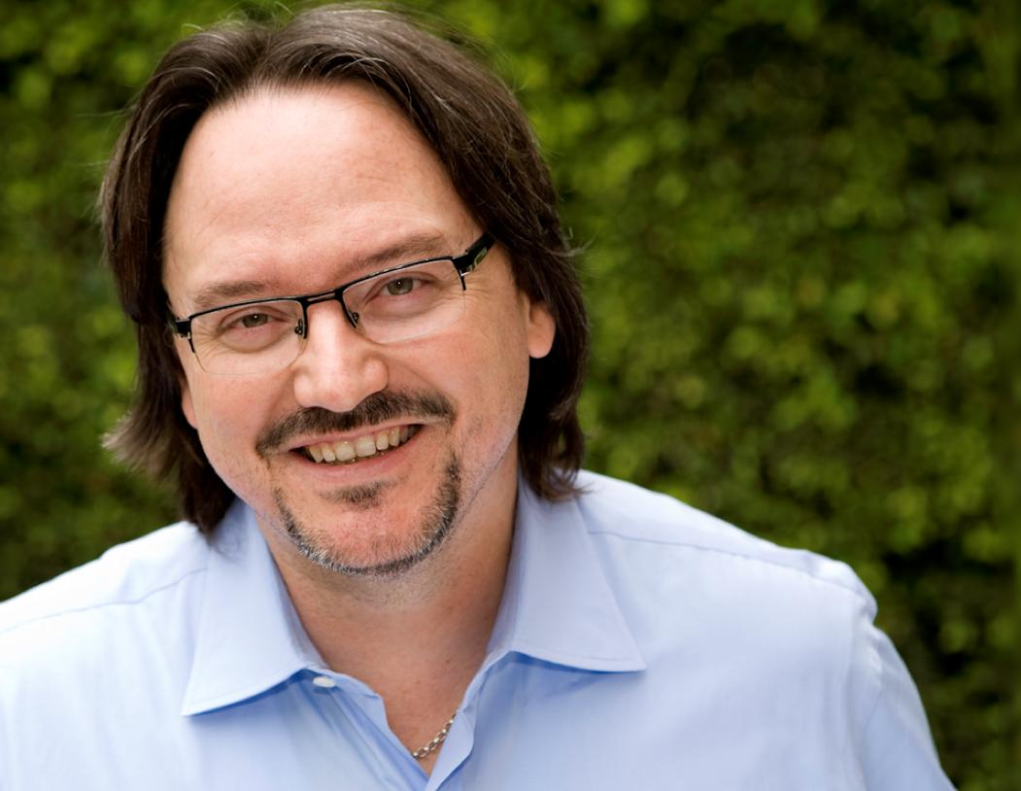
What is Content Marketing?
“Traditional marketing is telling the world you’re a rock star.
Content Marketing is showing the world you’re one!”
Robert Rose
Author
Killing Marketing

Slide 13
Sharing Means Caring
There’s more than one way to share…
Social media
Syndication
Email
And more (I’ll explain, I promise)
Being known means being visible!

Slide 14
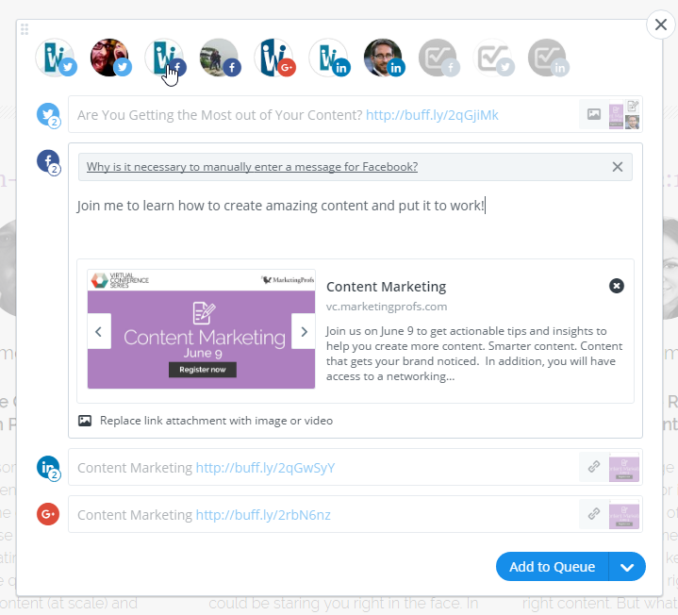
Social Media
Schedule your posts
Buffer →
Hootsuite
Share more than once
Share to multiple channels
Track and improve…

Slide 15
Syndication
Amplify your reach…
Setup an RSS Feed – can be simple XML or an email service like Feedburner
Site to Site Syndication – find industry websites and ask if they syndicate
Paid Syndication – use a service like Outbrain, Zemanta, and Taboola
Manual Syndication – post your content to Reddit, Medium, LinkedIn
This isn’t duplicate content, it’s reposted with permission!

Slide 16
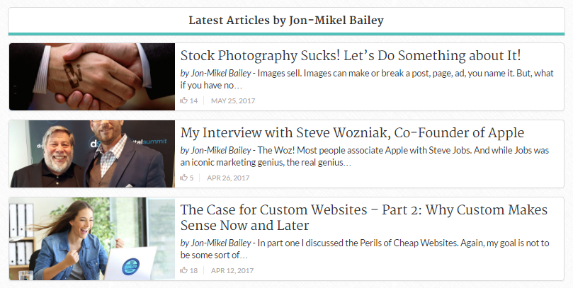
Syndication Site to Site

Slide 17
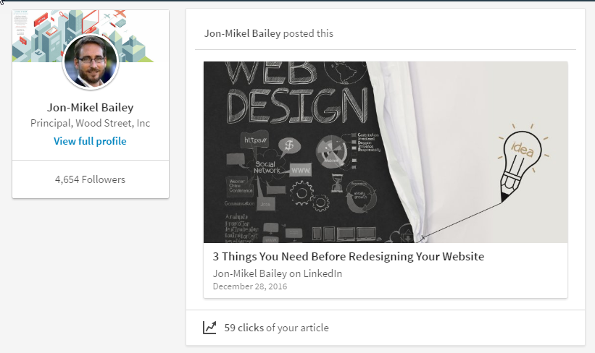
Manual Syndication - LinkedIn

Slide 18
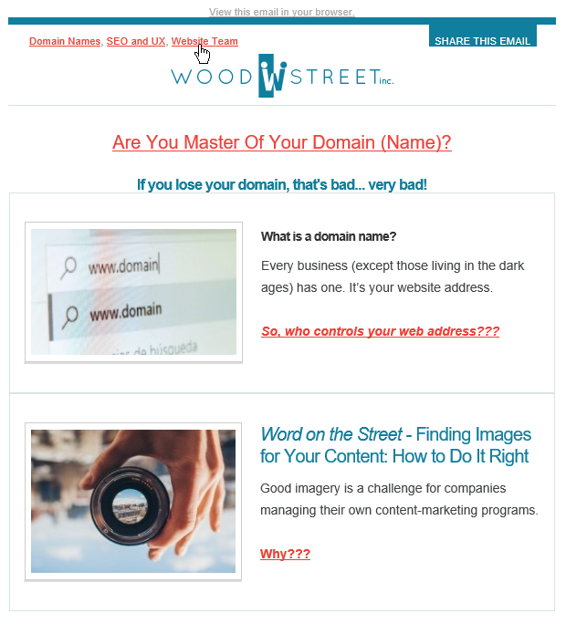
Email
Always include…
“View in Browser”
Preheader links
Images and clear links
Social share option
Your branding

Slide 19
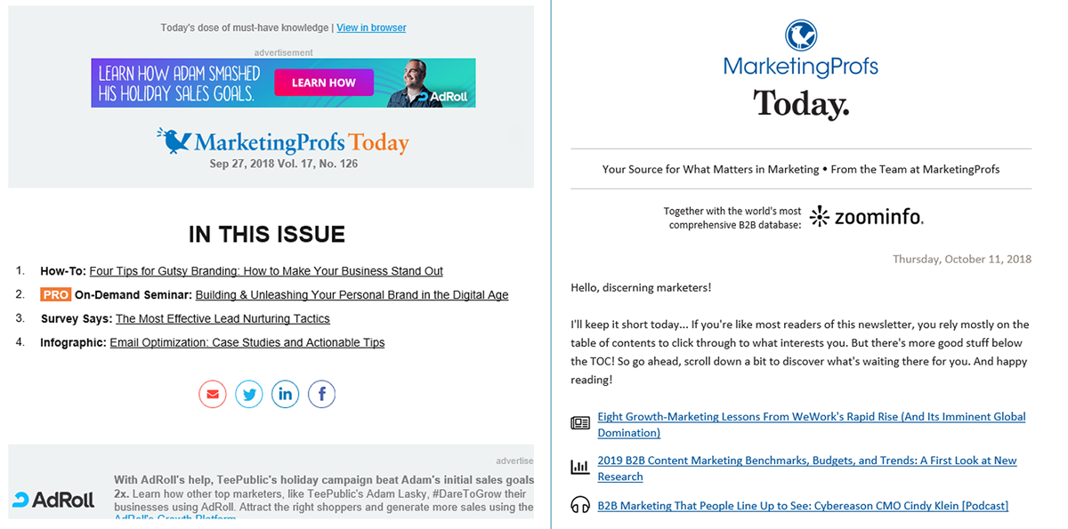
Email – The MarketingProfs Way

Slide 20
And More…
This list will always change, don’t ever stop looking…
SlideShare, AuthorShare – sites where you can post your preso slides
YouTube, Vimeo – video sharing services
Bookmarking sites – post your content on ScoopIt, BizSugar, StumbleUpon
PR – boost your content the old fashioned way, pay!
There will always be new places to post content, keep looking!

Slide 21
Being Trusted

Slide 22
Who is the User?
Who is Your Client? – profiles of a real user’s:
Goals: What do they expect to accomplish on your website?
Expectations: How do they envision the journey?
Motivations: What problem do they expect you to solve?
Behavior: How will they use your website? What’s their state of mind?

Slide 23
It’s the UX
Perceived value of website is high
Value to business owner
Such as increased market share, customer loyalty, etc.
Perception is validated through use
Proof = Trust which means they use an/or purchase on website.

Slide 24
In other words, good UX means good ROI, happy clients, better traffic…

Slide 25
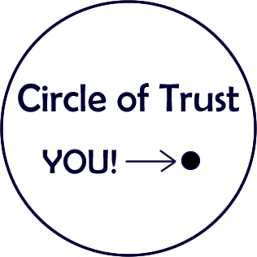
A Circle of Trust
Trust starts with actions…
Create good content that gets you found.
A user experience that delivers value.
Value that builds trust!
Trust that leads to shares, links, and a following!
This is a circle of trust. Make sure you stay in it!

Slide 26
Questions???
Suggested resources:
www.searchenginejournal.com
www.moz.com
www.businessgrow.com
www.marketingprofs.com
www.boagworld.com
www.searchenginewatch.com
Contact me/us:
www.woodst.com
jbailey@woodst.com
@woodstreetweb
@jonmikelbailey
Facebook.com/woodstreetweb
301.668.5006 x101

